Slide 1

Deep Learning
AIML
By
V. Raviteja,
Assistant Professor,
Dept. of Artificial Intelligence and Machine Learning
Aditya Engineering College(A)
Surampalem.

Slide 2

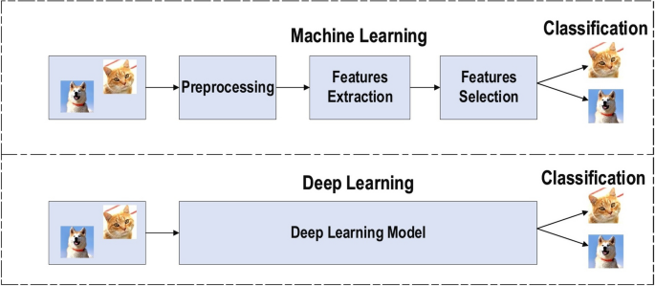
Need for Deep Learning
AIML
Traditional Machine Learning (ML) struggles with:
Large-scale unstructured data (e.g., images, videos, audio)
Feature extraction complexity
Increasing data availability and computing power
Complex tasks like image recognition, NLP, and speech require deeper models
Deep learning automates feature extraction and improves accuracy

Slide 3
Applications of Deep Learning
AIML
Computer Vision: Face recognition, Object detection, Medical imaging
Natural Language Processing: Chatbots, Machine translation, Sentiment analysis
Speech Processing: Speech-to-text, Voice assistants (Siri, Alexa)
Autonomous Systems: Self-driving cars, Drones
Healthcare: Disease prediction, Drug discovery
Finance: Fraud detection, Stock prediction

Slide 4
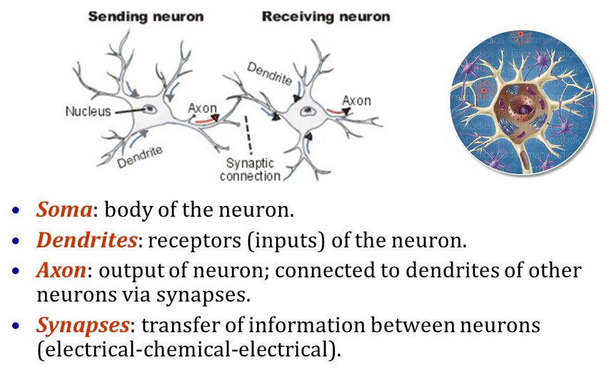
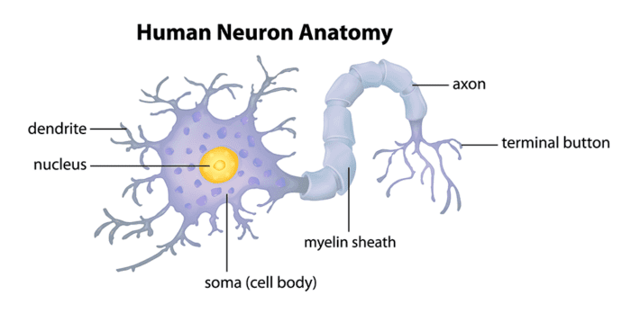
Motivation for Deep Learning
AIML
Inspired by the human brain’s ability to learn from data
Improved results in real-world tasks compared to classical ML
Scalability: Works well with Big Data and GPUs
End-to-end learning: from raw input to desired output
Success stories: Google Translate, AlphaGo, ChatGPT, Self-driving cars

Slide 5
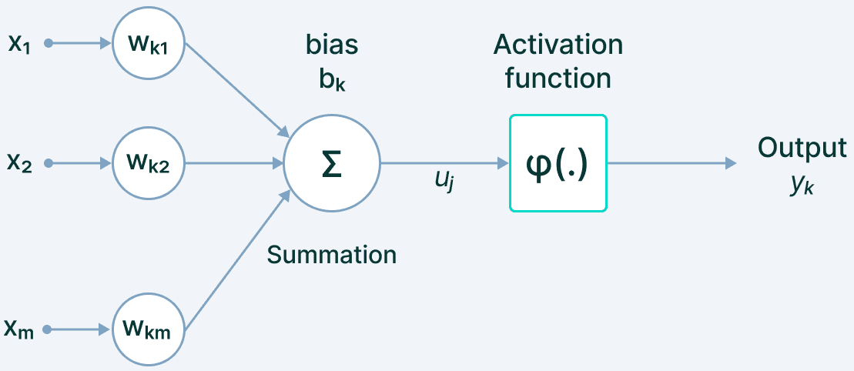
Computational Units
AIML
Artificial neurons simulate biological neurons
Takes multiple inputs → performs weighted sum → applies an activation function
Key Components:
Inputs (x₁, x₂, ... xₙ)
Weights (w₁, w₂, ... wₙ)
Bias
Activation Function
Output = Activation(sum of weighted inputs + bias)

Slide 6
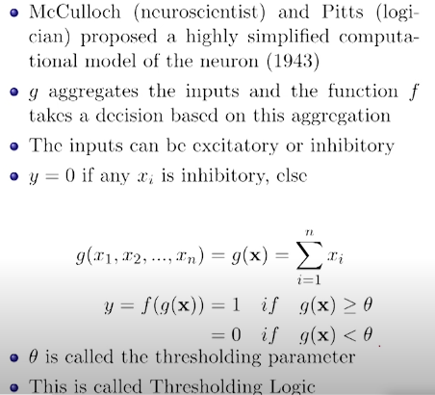
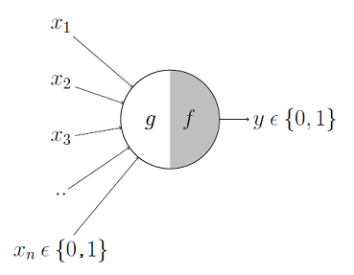
McCulloch – Pits Model
AIML

Slide 7
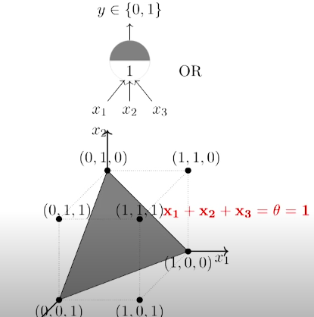
AIML
A Single McCulloch Pits neuron can be used to represent Boolean functions which are linearly separable.

Slide 8
Difference between M-P Neuron and Linear Perceptron
Feature | McCulloch-Pitts Neuron | Linear Perceptron
Inputs | Only binary (0 or 1) | Real or binary
Weights | Fixed/manual | Learned through training
Learning | No learning | Learns via perceptron learning rule
Activation | Hard threshold function | Step or sign function
Output | Binary (0 or 1) | Binary or real (based on activation)
Use Cases | Only logical functions (e.g., AND, OR) | Linearly separable problems (e.g., classification)
Model Complexity | Very simple | More advanced with adjustable weights

Slide 9
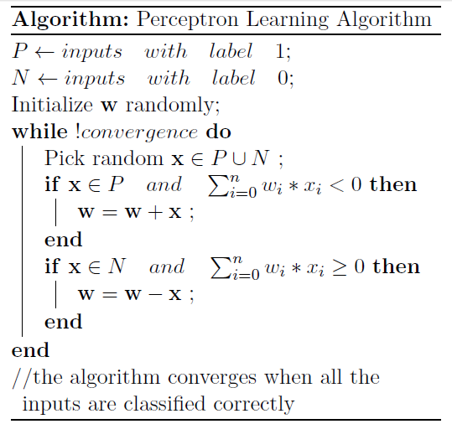
Perceptron Learning Algorithm
AIML

Slide 10
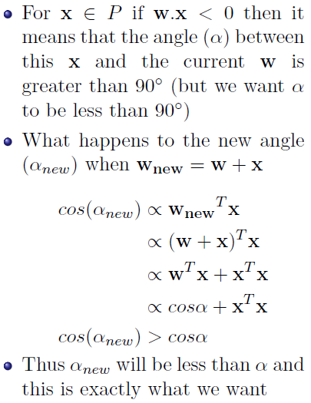
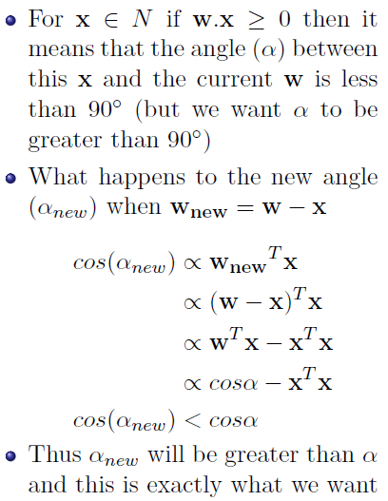
AIML

Slide 11
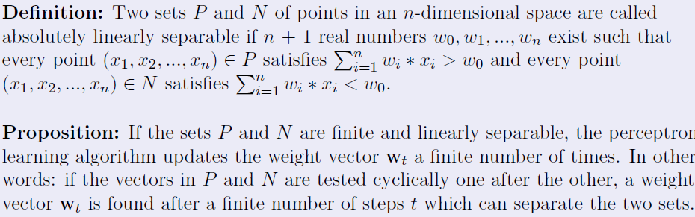
Proof of Convergence of Perceptron Learning Algorithm
Statement: The Perceptron Convergence Theorem states that if there exists a linear separation (a hyperplane) that can perfectly classify a given set of training examples, then the perceptron algorithm will converge to a solution that correctly classifies all the training examples.

Slide 12
Limitations of Perceptron Model
AIML
Linearly separable data: The perceptron algorithm works well only for linearly separable data. If the data is not linearly separable, the algorithm may not converge to a solution or may converge to a suboptimal solution.
Only binary classification: The perceptron algorithm is designed for binary classification problems, which means it can only classify data into two categories.
Sensitivity to initial weights: The convergence of the perceptron algorithm depends on the initial weights assigned to the inputs. If the initial weights are not chosen carefully, the algorithm may not converge or may converge to a suboptimal solution.

